Slide 1
Unit 4-5
USING CONGRUENT TRIANGLES: CPCTC
PLANE Geometry

Slide 2
Corresponding Parts of Congruent Triangles are Congruent
Abbreviated as CPCTC
If Two Triangles are Proven to be Congruent, then All Corresponding Parts are Congruent
  Triangles Can be Shown to be Congruent by SSS, SAS, AAS, ASA, or HL.

Slide 3






Example 1:
Write a Two-Column Proof.
Given: $\overline{AB}≅\overline{DB}, ∠C≅∠E$
Prove: $∠A≅∠D$
$$C$$
STATEMENTS | REASONS
$$A$$
$$B$$
$$D$$
$$E$$

Slide 4





Example 2:
Write a Two-Column Proof.
Given: $\overline{BC}≅\overline{DA}, \overline{AD}∥\overline{CB}$
Prove: $∠B≅∠D$
$$A$$
$$D$$
STATEMENTS | REASONS
$$B$$
$$C$$

Slide 5


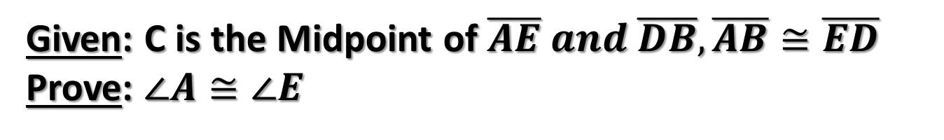



Example 3:
Write a Two-Column Proof.
Given: C is the Midpoint of $\overline{AE} and \overline{DB},\overline{AB}≅\overline{ED}$
Prove: $∠A≅∠E$
$$D$$
STATEMENTS | REASONS
$$A$$
$$C$$
$$E$$
$$B$$

Slide 6
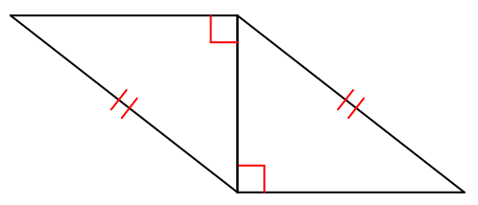
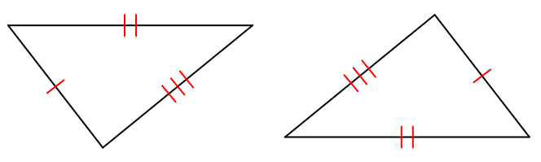
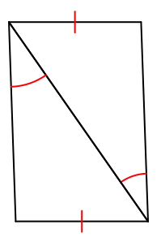
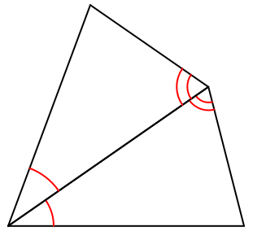
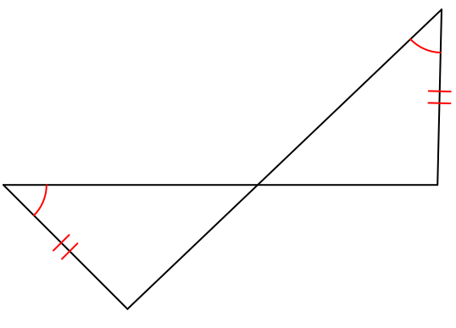
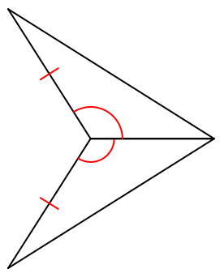
Example 4:
SSS, SAS, ASA, AAS, HL, or Not Possible?

